Slide 1
UNIT 6
Lecture 31
Gross National Happiness
Learning Outcomes
To identify the concept of happiness
To apply laws of positive psychology in real life situation.

Slide 2
Gross National Happiness:
It was coined in 1972
By Bhutan's former King Jigme Singye Wangchuck.
Gross National Happiness, measures the happiness(or subjective well-being) of the citizens of a country.
  Gross National Happiness (also known by the acronym:GNH) is a philosophy that guides the government of Bhutan

Slide 3
  An attempt to measure, through psychological and physiological means, a country's happiness, as a direct reference to GDP (Gross Domestic Product).
The trouble with GDP is that it is too narrow a measure of progress: it measures only economic output, leaving out other things that matter—like interpersonal trust, mental health, and environmental impact.
Contrast GDP with GNH—or Gross National Happiness, which measures the happiness(or subjective well-being) of the citizens of a country.

Slide 4
The concept of GNH has often been explained by its four pillars:
  good governance,
  sustainable socio-economic development,
  cultural preservation, and
  environmental conservation.
  The Gross National Happiness Index is a single number index developed from 33indicators categorized under nine domains.

Slide 5
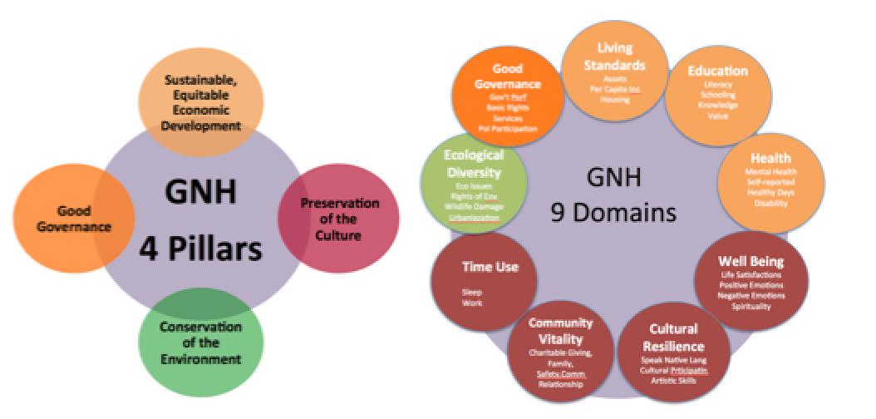
While measurement techniques vary, a widely used second-generation GNH metric uses seven areas–
  economic,
  environmental,
  physical,
  mental,
  workplace,
  social and
  political wellness,
gathered through a composite of quantitative and qualitative research.

Slide 6
GNH indicators
The 33 indicators under the nine domains aim to emphasize different aspects of wellbeing and different ways of meeting these underlying human needs. The indicators are further composed of 124 variables
The indicators are:
  Statistically reliable
  Normatively important,
  Accuracy across time
  Policy relevance
  Clarity of interpretation

Slide 7
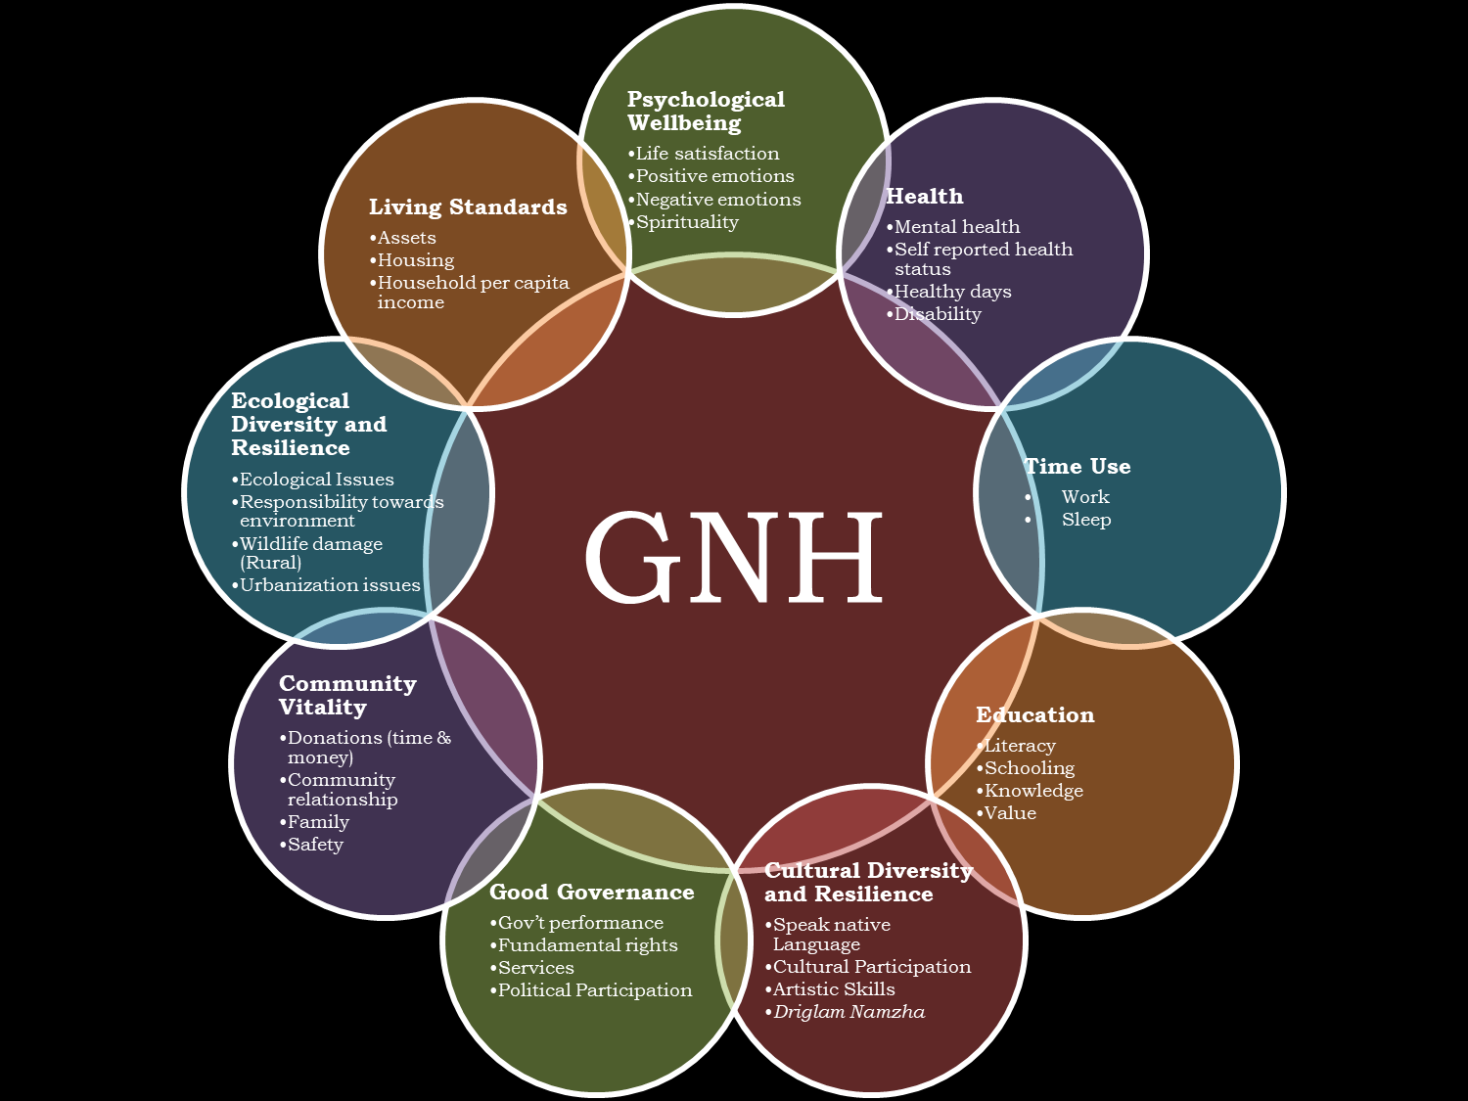
Notes:
Hypothetical classification of psychological wellbeing domain

Slide 8
GDP AND GNP
GDP :Gross Domestic Product
GNP :Gross National Product
GNH :Gross National Happiness

Slide 9
GNP ≠ GNH
“Gross National Happiness (GNH) measures
The quality of a country in more holistic way
[than GNP] and believes that the beneficial
development of human society takes place
when material and spiritual development
Occurs side by side to complement and
reinforce each other”

Slide 10
Lets Check!!!!
GNH metric uses how many areas?
Gross National Happiness Index is a single number index developed from how many indicators?
GNH index has how many domains?
GNH or GDP measures only economic output, leaving out other things that matter—like interpersonal trust, mental health, and environmental impact?
Full form of GDP.

